Slide 1
Communicating an
Analytics Project
Copyright 2021, the Board of Regents of the University of Oklahoma.

Slide 2
DATA ANALYTICS LIFECYCLE
Discovery
1
Operationalize
6
Data Preparation
2
Communicate Results
Model Planning
5
3
Model Building
4
Source: Services, 2015, pp. 26-30
Notes:
After modeling:
Compare outcomes to the criteria established for success and failure.
Consider how best to articulate results to each member.
Record all findings – select the three most significant findings.

Slide 3

TELLING A STORY
"Make sure a candidate can find a story in a data set and provide a coherent narrative about a key data insight... "
- Harvard Business Review
Notes:
An article from the Harvard Business Review on how to interview for and find good data scientists contained an interesting quote – the CEO they interviewed stated that you should make sure your candidate can find a story in a data set and provide a coherent narrative about a key data insight.
The art of finding the right insight to best answer the problem AND to interpret it, understand its potential and limitations, AND to effectively communicate is human skill that is critical for success.

Slide 4
TELLING A STORY
Be aware of context
Know you audience
Focus your message: Big Idea
Tell a story

Slide 5
UNDERSTAND CONTEXT
Success in data visualization starts with understanding context and making a plan.
Who, what, how?
Understanding the context of the communication means understanding…
Who is your audience? Be specific
What action should the audience take? Be explicit
How can you use data to help make your point? Be discerning
Notes:
As with almost anything, success in communicating through visualization begins with having a plan. In this case that means we need to understand context. Here means having a firm grasp of
Who your audience is – be specific
What action you want your audience to take – be explicit
How will you communicate with your audience – be discerning
Depends on your medium. Are you presenting in person?
If you, you have a higher degree of control over how the audience consumes your data. Not everything has to go on the slide deck
If you’re not communicating in person, you have less control over how the audience consumes the data. More detail is required in this setting.

Slide 6
KNOW YOUR AUDIENCE
Make a list of every audience who might be interested
Narrow, narrow, and narrow again
Given some insight about the data, narrow your audience
Given a specific recommended action, narrow your audience once again.
Consider immediacy: what needs to happen now to make the recommended action happen?
Research your audience to know them better
Notes:
Before we can build our data visualization, it’s important to know who our primary audience is. This can potentially include a wide range of people, but it is important to be specific.
The way you tell your story will vary depending on the audience.
For example, when communicating with a technical audience, you’re more likely to utilize graphics and vocabulary that they understand. You’ll probably go into greater detail on the technical components of your analysis.
However, when communicating with business users, you’re better served to be less technical in your presentation. Focus on the business impact of your analysis.
Start with a wide group, and work to narrow the field.
Get to know the target audience through research. What do they care about?
So we know for whom we’re creating the visualization. The next step is to focus your message.

Slide 7
KNOW YOUR AUDIENCE
Project sponsors
Present high-level takeaways and information that aids in decision making.
Clean, easy-to-understand visuals.
Frame in terms of value to the unit or organization.
Technical audience
Provide the technical details: methodology, findings.
More technical graphs (distributions, ROC curves, etc.).
Use data visualization where possible.

Slide 8
FOCUS YOUR MESSAGE
We know our primary audience and what motivates them.
We have identified the stakes (benefits, risks).
Form your BIG IDEA
One sentence which…
Articulates your point of view and
Conveys the stakes
Critique the BIG IDEA
Is your point of view clear?
Are the stakes clear?
Is your BIG IDEA compelling?
Notes:
Critique the BIG IDEA
Is your point of view clear?
Are the stakes clear?
Is your BIG IDEA compelling?
I encountered the BIG IDEA in Cole Nussbaumer Knaflic’s Storytelling with Data…she gives credit to Nancy Duarte (Resonate, 2010)

Slide 9
SCENARIO
You work in utility customer analytics and have been asked to investigate customer satisfaction. During your investigation you found a noticeable increase in call waiting time in March corresponding to a decrease in customer satisfaction.
Question: Who (groups, individuals) might care about call center performance?
Call center management, analytics colleagues, senior leadership (?)…
Notes:
Question for audience: How many different groups can you come up with who might be interested in the survey data you’ve analyzed? Make a list
Here are a few: analytics colleagues, call center management…senior leadership?

Slide 10
SCENARIO
Further investigation revealed that the organization pushed a promotional campaign in early March that featured a compelling cost savings program. Many customers called for further details and were frustrated with long call waiting times.
Question: Which potential audiences would care about this? List them.
Call center management, marketing department…
Notes:
Marketing: whoever oversaw the promotional campaign, a person or group that designs the website…
--------------
After narrowing: the manager of the marketing campaign and the call center management are equally important audience members…they care about…creating a strong positive customer experience

Slide 11
SCENARIO
Narrow your list: if you must select a single person to communicate your insights, who is it?
What is your recommended action?
What is at stake?
What are the benefits of taking action?
What are the risks of maintaining status quo?

Slide 12
FORM YOUR BIG IDEA
Who is your audience?
Primary audience…Marketing department and call center management
Audience motivation…Provide strong positive customer experience
Recommended action? Increase communication to ensure we meet customer demand
What is at stake?
Benefits…More informed customers and more satisfied customers
Risks…Fewer customers taking advantage of the promo; decrease in customer satisfaction
In a single, complete sentence: (1) articulate your point of view, and (2) convey the stakes.
Improving communication between departments will help ensure customers remain informed and satisfied.
Notes:
Who is your audience?
List the primary groups to whom you’ll be communicating. Marketing personnel who oversee the promotion of the energy efficiency program; call center management.
What does your audience care about? Customer understanding; improving overall customer satisfaction.
What action does your audience need to take? Increase interdepartmental communication to ensure we meet customer demand.
What is at stake?
List the benefits of taking action on your recommendations. Shorter call waiting times, more customers opting into the program, and more satisfied customers.
List the risks of not doing so. Fewer customers taking advantage of the program; decrease in customer satisfaction; bad word of mouth; customer churn.
Form your BIG IDEA: In a single, complete sentence:
Articulate your point of view
Convey what is at stake
Improving communication between departments will help ensure customers remain informed and satisfied.

Slide 13
DISCUSSION
How can you take the various needs of your audience into account when communicating with your data?
Have you communicated with a mixed audience? How can you set yourself up for success when communicating with multiple groups?
What tools do you know of that might be good alternatives to sticky notes?
Are there different processes (or components) that you’ve used in the past that might be a helpful alternative to (or used in conjunction with) the process we’ve just discussed?

Slide 14
TELLING A STORY
A story is a set of observations, facts, or events that are presented in a specific order such that they create an emotional reaction in the audience. It has a narrative arc.
Set up your story – consider the…
Setting – when/where does the story take place?
Main character(s) – who is driving the action?
Imbalance – why is action necessary?
Balance – what change can help restore balance?
Solution – how can you/your audience bring about the recommended change?
Notes:
Now we know our audience, we have a concise, explicit takeaway, and our data to back it up...we have what we need to deliver our message now.
We can make our message most effective through story.
Communicating through story
Helps engage our audience
Increases the likelihood that the audience will remember what your message.
Your goal in telling a story should be to use facts and logical reasoning to get your audience interested and excited – and ultimately, to persuade.
We want to use a structure in storytelling called narrative arc: The structure of the story that includes build-up of tension from the beginning of the story, followed by some type of resolution.
-----
Consider the following questions when setting up the story:
When and where does the story take place (i.e. the setting)?
Who is driving the action (i.e. the main character)?
Why is some action necessary; what has changed (i.e. the imbalance)?
What change can help restore balance (i.e. the balance)?
How can you or your audience bring about the changes (i.e. the solution)?

Slide 15

STORYBOARDING
A storyboard is a visual outline of your content in a low-tech format.
Steps
Brainstorm
Edit
Get feedback
Sticky notes
Avoid attachment
Force concise articulation
Easily rearrange story flow
Notes:
After you’ve identified your audience and insight, you can use a technique called storyboarding to ensure your communication is organized and effective.
Cole Nussbaumer Knaflic stresses “storyboarding is the most important thing you can do up front as part of the planning process to reduce iterations down the road and create better targeted materials.” (SWD-LP, 20)
TIP: Use sticky notes
Avoid attachment to your ideas
Force concise articulation
Easily rearrange the flow

Slide 16
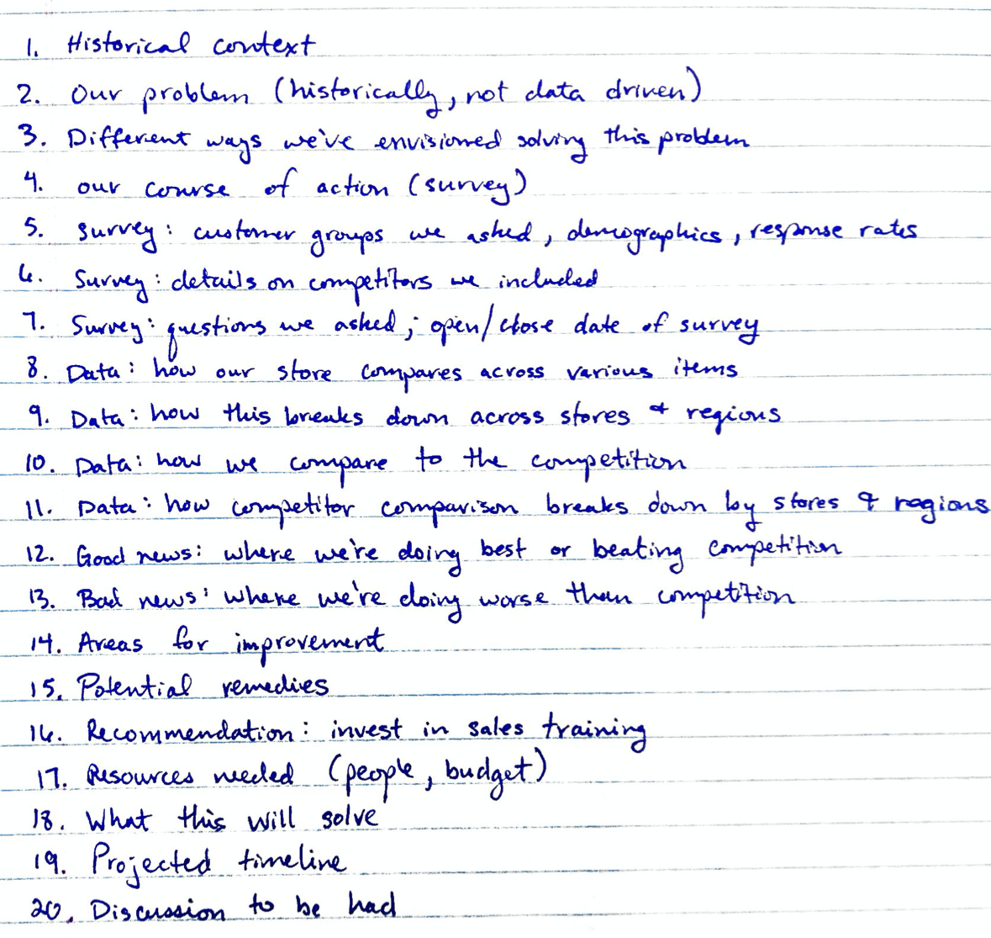
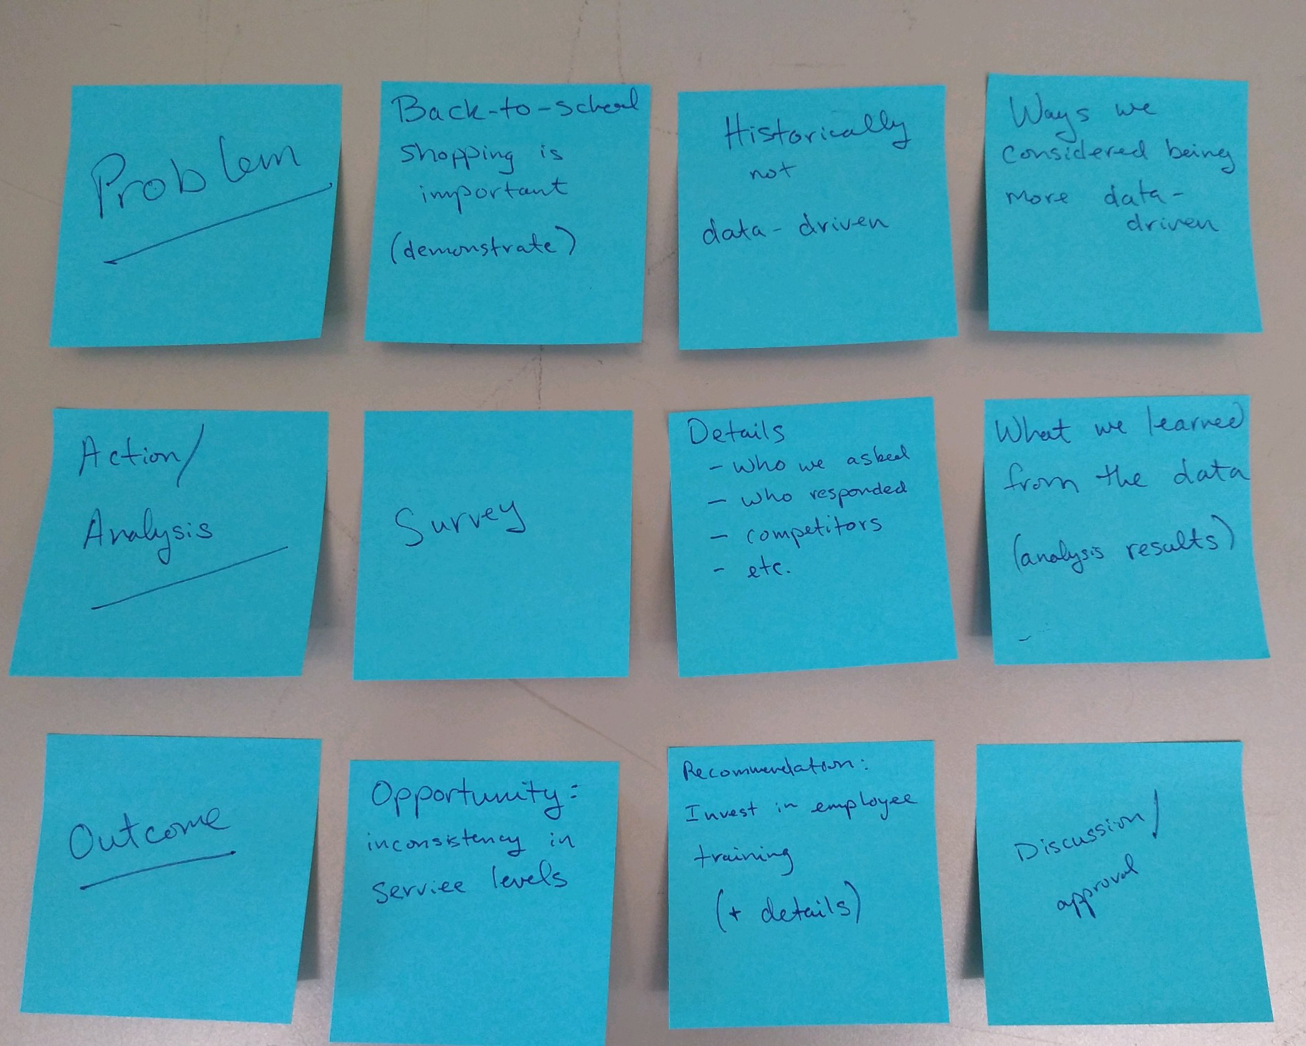
List Storyboard

Slide 17
IMPROVE YOUR STORY
Ensure your story is clear
Use Repetition
Horizontal logic
Vertical logic
Reverse Storyboarding
Fresh Perspective
Help move information from short-term to long-term memory.
Bing - Bang - Bongo
Notes:
Use the following tactics to ensure your story is clear.
Horizontal Logic
The audience should be able to read just the slide titles throughout the deck and understand the overarching story
Checking for horizontal logic is one approach to test whether the story you want to tell is coming through clearly in your deck
Vertical Logic
All information on a given slide is self-reinforcing
For example, the content enforces the title and vice versa – no extraneous or unrelated information.
Reverse Storyboarding
Flip through the final piece of communication, and write down the main point from each page
The story you tell should match the original storyboard
Help with horizontal logic too
Fresh Perspective: ask a friend or colleague to edit
What do they pay attention to?
What they think is important?
What do they have questions on?
---------
Memory: the more likely something is used, the more likely it is to end up in long-term memory.
Bing, Bang, Bongo:
Set expectation for how the communication will go
Provide detail
Recap

Slide 18

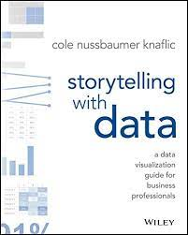
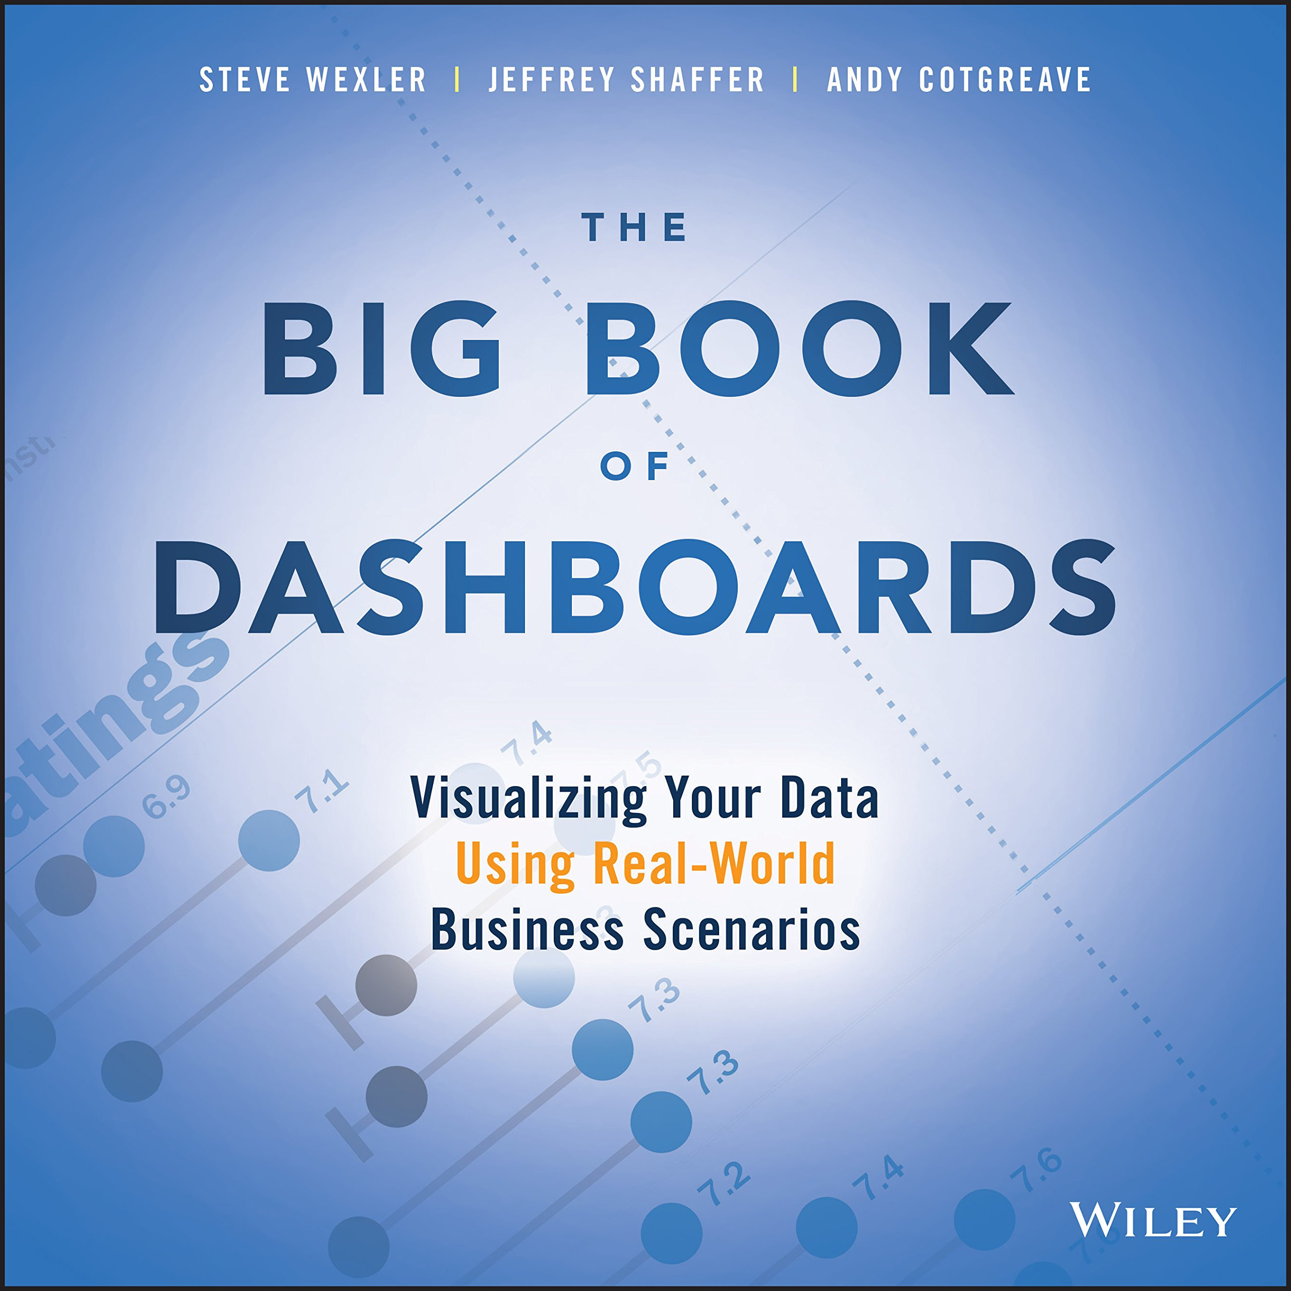
SUMMARY
Be aware of context
Know you audience
Focus your message: Big Idea
Tell a story
Narrative arc (storyboarding)
Repetition
Ensure clarity

Slide 19
OPERATIONALIZE
Implement a small-scope pilot project
Plan for ongoing monitoring
Model accuracy
Inputs
Deliverables
Presentation for technical and non-technical audiences
Code
Technical specifications
Notes:
Implement a small-scope pilot
Mitigate risks
Investigating (or demonstrating) value in a live environment.
Learn about limitations in production environment.
Plan for ongoing monitoring
Monitor model accuracy; if degradation is identified, retrain the model.
Deliverables
Presentation for technical and non-technical audiences
Code
Technical specifications

Slide 20
End of Session 3
Review
Data & Analytics Overview
Analytics levels
Maturity index
Analytics lifecycle
Data visualization tips
Relational DB & SQL
Communicating Results
Application: Putting it all together with Python
Please complete an anonymous survey.
Notes:
Survey: https://forms.office.com/r/PtkTekBjpA

